Slide 1
Microsoft-Teams Apps – Advanced-Techniques
Anders Dissing, Microsoft Office Servers and Services MVP

Slide 2
Microsoft-Teams Apps – Advanced-Techniques
Advanced Teams Bot capabilities

Slide 3

Advanced Teams Bot capabilities _
Teams-Bot-extensions
Respond to events
Updating messages/cards
Dialogs, prompts and menus
Demo

Slide 4
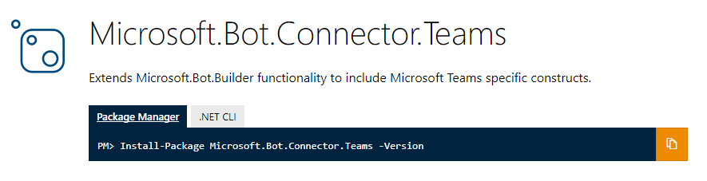
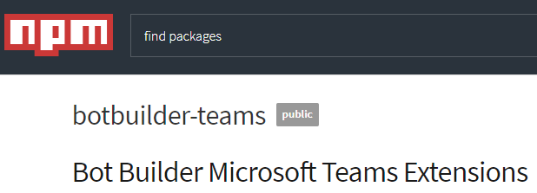
Teams-Bot-extensions
Extensions and utilities
ConnectorClient
Parse activities to system events
Parse activities to channel/member information
Extract @mentions from text
ProcessAttachments
Data models
Tenant
Team/channel
ComposeExtension
Cards
Tenant filtering
Notes:
Extension library accelerates development
Manages connection to Bot service – facilitates updats
Types to represent events
Strongly-typed data models

Slide 5
Respond to events
Reach out to users as they are added to Team
Respond to changes in Team/Channel
Type | Payload object | Teams event type | Description
conversationUpdate | membersAdded | teamMemberAdded | Bot or team member was added to team
conversationUpdate | membersRemoved | teamMemberRemoved | Bot or team member was removed from team
conversationUpdate |  | teamRenamed | Team in which bot is member was renamed
conversationUpdate |  | channelCreated | In a team where bot is member, a channel was created
conversationUpdate |  | channelRenamed | In a team where bot is member, a channel was renamed
conversationUpdate |  | chanelDeleted | In a team where bot s member, a channel was deleted
contactRelationUpdate |  |  | Not directly supported in Teams
deleteUserData |  |  | Not directly supported in Teams
Notes:
First two events are most relevant
The bot itself is a team member

Slide 6
Demo Responding to events
Notes:
Run the demo: Responding to Events

Slide 7
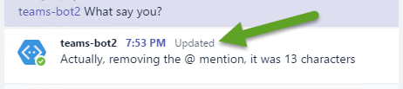
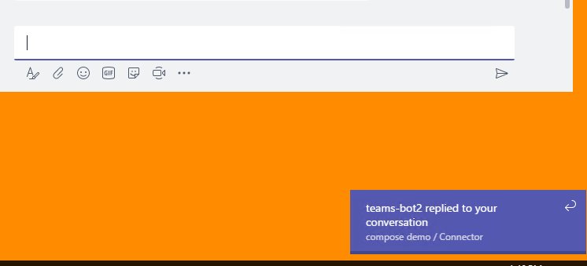
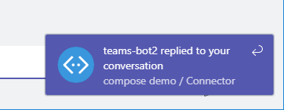
Advanced message features
Bots encourage conversation about information
Keep that information up-to-date
Update activity via SDK or REST
Updates message and attachments
Initiate 1:1 or channel conversation
Be proactive about state in your service
Alert users for important events
Don’t be noisy, be helpful
Notes:
Alerts depend on the client in use. For Windows desktop, it is a toast notification. For web, it is floating div on top of canvas

Slide 8
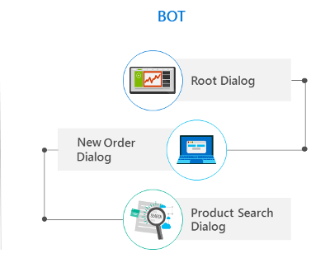
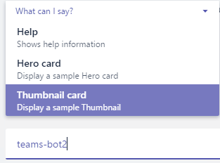
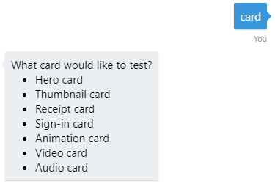
Interacting with a Bot
Dialogs
Directs conversation
Stack of dialogs – top one gets message
Scorable dialogs always respond to their commands
Prompt dialog
SDK-provided dialog
Declare choices in code
Top of stack until valid choice selected
Provide option to quite or limit number of attempts
Bot menu
Teams-specific implementation
Declare choices in manifest
Guides user, but can type anything
Keep it short & simple
Notes:
Scorable dialog registered as Global Handler in Application_Start
Prompt dialog called from other dialogs
Bot Menu is not in Bot code – only manifest & Teams client

Slide 9
Demo Advanced message features
Notes:
In a channel or chat
send the bot the message “ping” to invoke an alert.
Send message “Hero card” or “Thumbnail card” to get one back. Show picking from menu
Send any other message to have the character count returned and updated.
(works best in channel, where message has @ mention )

Slide 10

Summary
Design thought – don’t build a robot, build a bot
Deployment chain for debugging with ngrok
Design thought – don’t build a robot, build a bot
Deployment chain for debugging with ngrok

Slide 11

Compose Extensions-
Introduction to Compose Extensions
Deep-dive into building extension
Demo

Slide 12

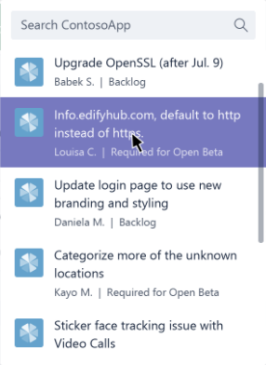
Introduction to Compose Extensions
Share your content in a channel or chat
Users select entity from your extension/app
Card added to message
Conversation is about an item in your service
Entity display is customizable
Initial display control
Automatic rendering & submission of search
You decide entities and render in cards

Slide 13
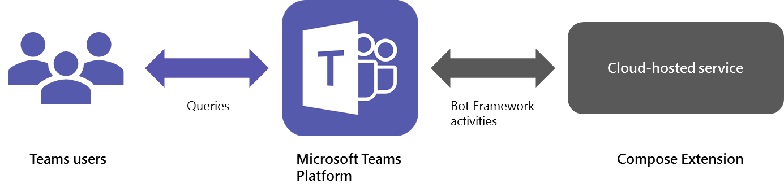
Deep-dive into building extension
Extends the compose window
Provides rich user interface for selecting information to include in message
Leverages bot communication (Activities, schema)
Notes:
At its core, a compose extension is a cloud-hosted service that listens to user requests and responds with structured data, such as cards. You integrate your service with Microsoft Teams via Bot Framework Activity objects. Our .NET and Node.js extensions for the Bot Builder SDK can help you add compose extension functionality to your app.

Slide 14
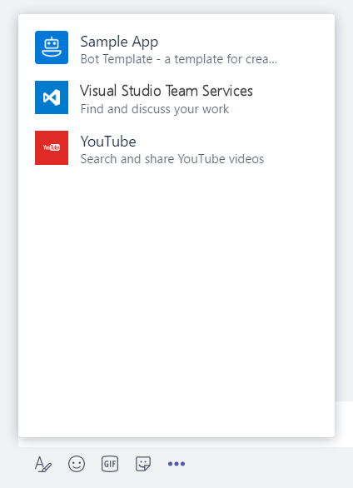
Deep-dive – Manifest
"composeExtensions": [ { "botId": "[MicrosoftAppId]", "scopes": [ "team" ], "canUpdateConfiguration": true, "commands": [ { "id": "searchCmd", "description": "Search Bot Channels", "title": "Bot Channels", "initialRun": false, "parameters": [ { "name": "searchText", "description": "Enter your search text", "title": "Search Text“ } ] } ] } ]
composeExtension node
Associated with a registered application
Personal and Team scopes
Define command UI and parameter
Multiple extensions
Your extension shown along with all others added to Teams
Notes:
commandExtension is part of the manifest.json file
Scope determines if 1:1 (personal) or channel (team)

Slide 15
Deep-dive – Command
Manifest properties describe command. UI is generated by Teams
Property name | Purpose
id | Unique ID that you assign to this command. The user request will include this ID.
title | Command name. This value appears in the UI.
description | Help text indicating what this command does.
initialRun | If set to true, indicates this command should be executed as soon as the user chooses this command in the UI.
parameters | List of parameters.
parameter.name | The name of the parameter. This is sent to your service in the user request.
parameter.description | Describes this parameter’s purposes or example of the value that should be provided. This value appears in the UI.
parameter.title | Short user-friendly parameter title or label.
Notes:
All are required except “initialRun”. Should included it for completeness, just set value to false.

Slide 16
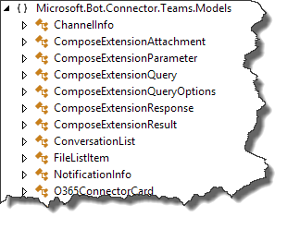
Deep-dive – Events
Activity payload
Type is invoke
Name identifies type of event
composeExtension/query
composeExtension/querySettingUrl
composeExtension/setting
Sent to registered bot endpoint
Teams Connector NuGet package provides detection methods and data models

Slide 17
Deep-dive – Events
Query events
Query data sent to bot
Activity.GetComposeExtensionQueryData()
Verify commandId and parameters
Use parameter value to query your service
Respond with attachment layout of “List”
Hero Card
Thumbnail Card
O365Connector Card

Slide 18
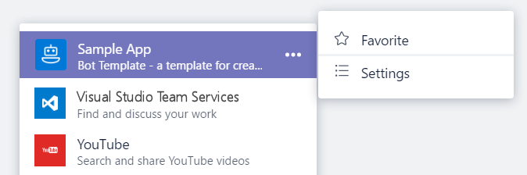
Deep-dive – Events
Settings events
If canUpdateConfiguration is true, Teams wil send Settings events in response to user action
onQuerySettingsUrl
Sent when “Settings” clicked
Return Url of settings page
Teams will render page
onSettingsUpdate
Sent when settings page is closed
Storage of settings is developer responsibility

Slide 19

Deep Dive – Other considerations
Authenticated requests to Extension service
Activity payload includes a Teams-generated id that represents the user
Activity payload includes Channel/Team/Tenant IDs
Authenticating users to your system
No tokens!
Response to query event can be auth command instead of result
Provide Url to page that initiates login/token acquisition
Developer must associate Token/UPN with Teams-provided ID

Slide 20
Demo Compose Extensions
Notes:
The demo extension searches against a list of channels supported by the bot framework. Type “sky” or “team” in the search box to find popular Microsoft channels

Slide 21
Summary
Compose Extensions

Slide 22

Microsoft Teams Apps with multiple capabilities
Integrating external systems using connectors / webhooks
Combining capabilities in a Teams App
Demo

Slide 23
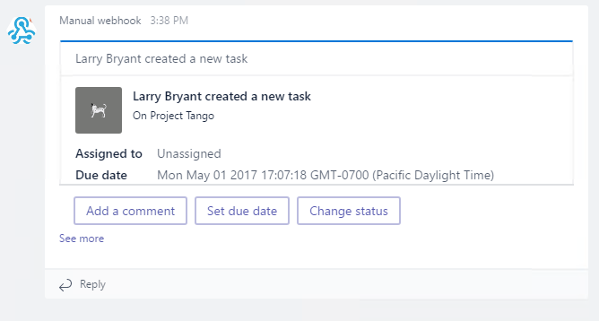
Integrating external systems using connectors / webhooks
Activity posted to Channel
Rendered as any other message
Text
Card
Actionable Card
POSTed to registered endpoint
Incoming Webhook
Teams provides URL, must be copied
Office 365 Connector
Automated flow for capturing URL
Requires registration and publication

Slide 24
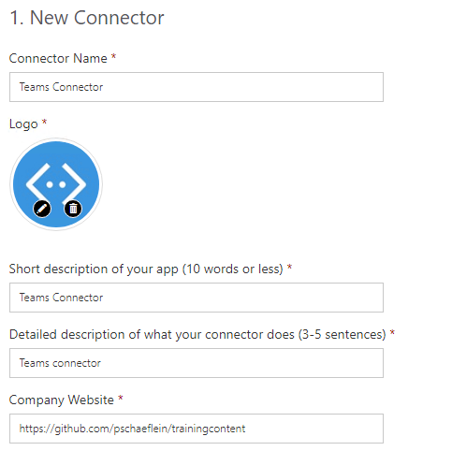
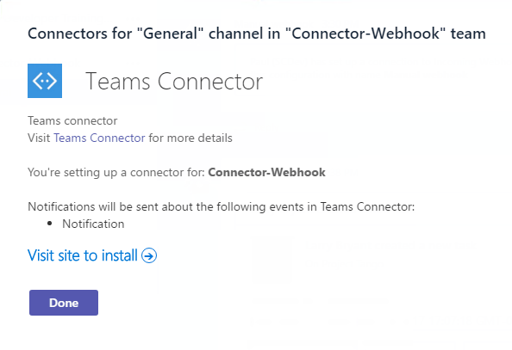
Connector - Manifest
connector node
Identifies registered connector via connectorId
Information provided during registration shown when adding to Channel
"connectors": [ { "connectorId": "[ConnectorAppId]", "scopes": [ "team" ] } ]
Notes:
connectors is part of the manifest.json file

Slide 25
Demo Connector / webhook
Notes:
This demo uses developer utilities to create a card via a webhook and shows the Connector registration pages.

Slide 26




Teams App contains multiple capabilities
Tabs and conversations
Tabs give your app a dedicated canvas that allows people to jump between conversations and your experience.
Customizable cards
Cards let you surface important tasks, information, and reminders in actionable ways.
Bot framework
The Bot framework offers a natural language UX that can interact with your services.
Compose extensions
Compose Extensions are quick and easy shortcuts to key components f your service.
Notes:
This information comes from the Microsoft Teams Design Guidelines: http://msteamsdesignguidelines.azurewebsites.net/#!/
All of these capabilities are possible in an app, not in a custom bot.
Not all are required. Only publish those that make sense, or start with one and build out over time.

Slide 27
Multiple capabilities – Manifest
Top-level nodes
Use what you need
Single package
Same icons
Same names
Same descriptions
Easy deployment
{ "$schema": "https://statics.teams.microsoft.com/...",
"manifestVersion": "1.0",
...
"configurableTabs": [],
"staticTabs": [],
"bots": [],
"connectors": [],
"composeExtensions": []
}

Slide 28
Demo Multiple capabilities
Notes:
After adding the Connector to the existing bot, Sideload to a new team. Notice that the TeamMembersAdded event fires and the bot initiates a 1:1 conversation. And, the Connector shows in the sideload section of connector dialog.

Slide 29
Summary
Connectors / webhooks
Multiple capabilities

Slide 30
Hands-on Labs Microsoft Teams apps - Advanced Techniques

